Slide 1

Capstone Project
By Mohamed Ali Raihan

Slide 2



Personal BACKGROUND
(Name, Past Experience, Qualification, Career Summary)
Name : Mohamed Ali Raihan M
Past Experience : Fresher
Qualification : B.Tech Information Technology
Career Summary : Fresher
www.collaberadigital.com

Slide 3


Key Takeaways/Learnings from the Program (HTD)
I had a basic understanding of Java and OOP concepts, but this program allowed me to significantly deepen my knowledge.
I started with the fundamentals, gaining proficiency in MySQL, JDBC connectivity, Hibernate ORM, Spring MVC, and Spring Boot. This solid foundation helped me build more complex applications.
I developed a strong understanding of entity relationships, which is crucial for designing robust databases. With these skills, I can now confidently design and develop Spring Boot applications and microservices.
I also learned how to implement security in Spring Boot using JWT, ensuring my applications are secure and reliable.
Additionally, I gained valuable insights into Git and GitHub, enhancing my ability to manage code and collaborate effectively on projects.

Slide 4
Java is a high-level, class-based, object-oriented programming language that is widely used for building a variety of applications.
Key Features of Java
Platform Independence:
Java’s allows the same code to run on any platform that supports Java, without needing to be recompiled.
Object-Oriented Programming (OOP):
Java is built on the principles of OOP, which include concepts like inheritance, encapsulation, polymorphism, and abstraction.
Automatic Memory Management:
Java uses automatic garbage collection to manage memory, freeing developers from the burden of manual memory allocation and deallocation.
Advantages of Using Java
Versatility:
Java is used in various domains, including web development, mobile applications
Scalability:
Java applications can scale easily, making it suitable for both small and large applications.
JAVA

Slide 5
SPRING BOOT
Java Spring Boot is an extension of the Spring framework that simplifies the development of standalone, production-grade Spring-based applications. It is designed to get applications up and running quickly with minimal configuration.
Key Features of Spring Boot
Auto-Configuration:
Automatically configures the application based on the dependencies you add
Microservices Support:
Ideal for developing microservices due to its lightweight nature and ease of integration with other services.
Convention Over Configuration:
Follows sensible defaults to reduce the need for complex configurations.
Advantages of Using Spring Boot:
Rapid Development:
Speeds up the development process by reducing the amount of boilerplate code.
Flexible and Extensible:
Easily customizable to fit different project needs.

Slide 6

Problem Statement of the Capstone Project
To develop a backend application for online shopping with the following modules
and functionalities:
Product:
Create new products in the inventory.
Read and retrieve product details.
Update existing product information.
Delete products from the inventory.
Reduce product quantity when an order is successfully placed.
Customer:
Create new customer.
Read and view customer information.
Update customer details.
Delete customer profiles.
Enable customers to add products to their cart.
Allow customers to place orders.
Display the contents of the customer’s cart.
Show the customer’s order history.

Slide 7
Problem Statement of the Capstone Project
Cart:
Hold products that the customer has added.
Display the total number of items and cost in the cart.
Allow customers to remove items from the cart.
Update the cart when products are added or removed.
Order:
Enable customers to place orders for the products in their cart.
Display order details, including order status.
Allow customers to cancel orders.
Manage order status updates (e.g., processing, shipped, delivered).

Slide 8
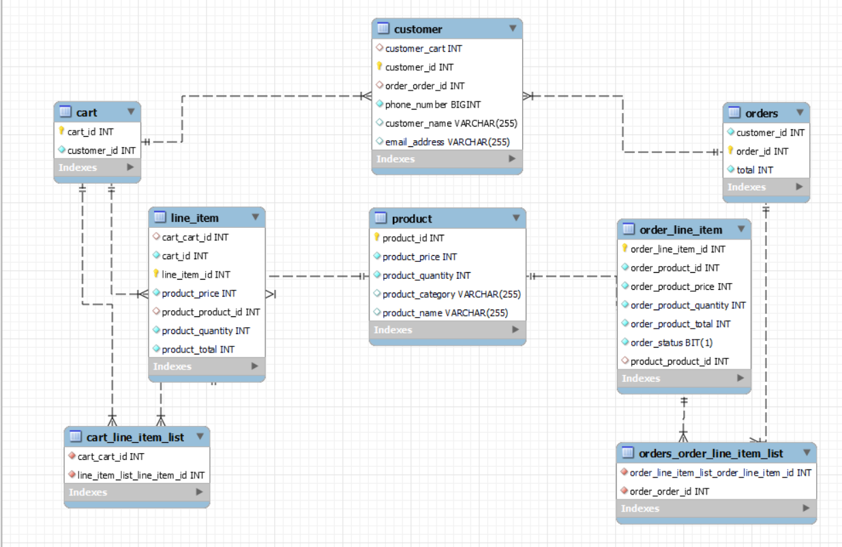
Class Diagram of Online Shopping

Slide 9
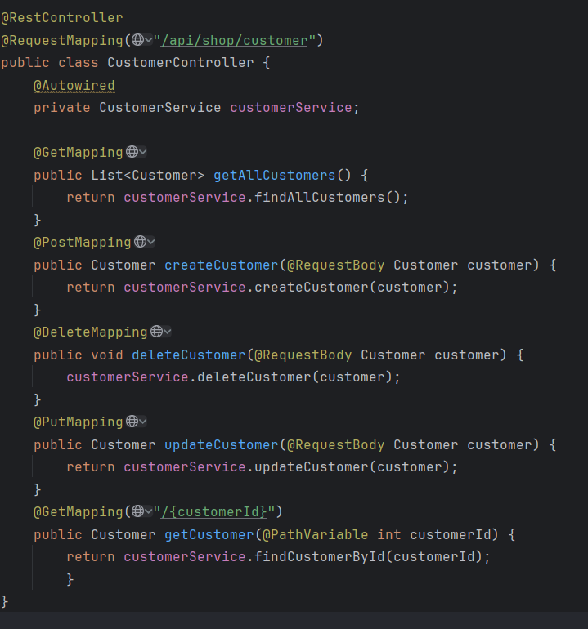
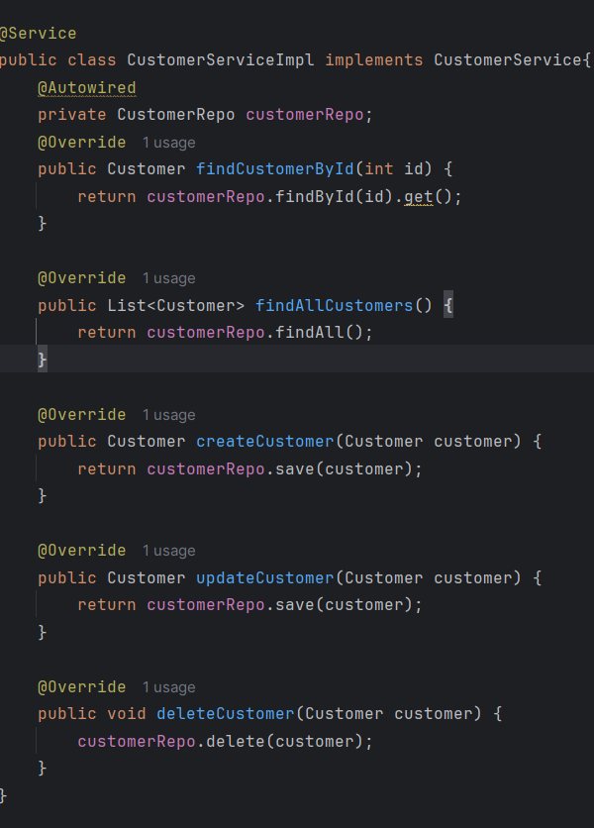
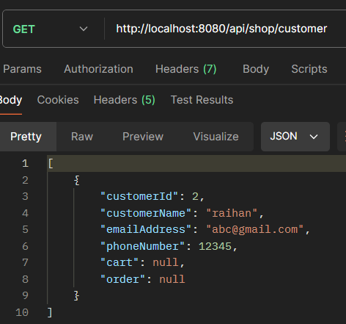
Online Shopping Application – Customer Module
Customer Module Endpoints
Customer Module Service Class
Customer Output

Slide 10
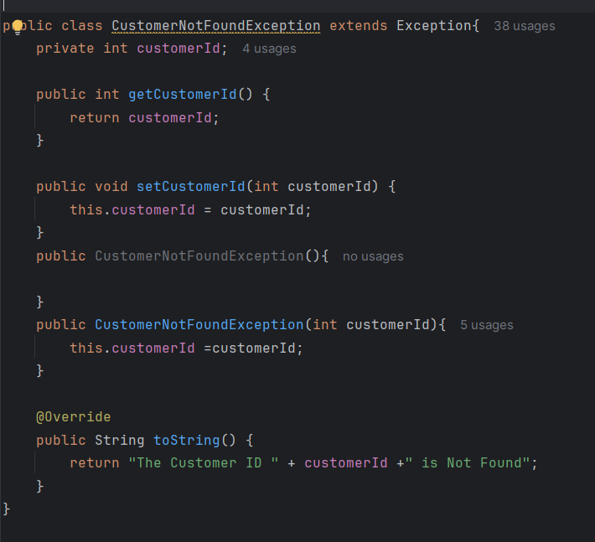
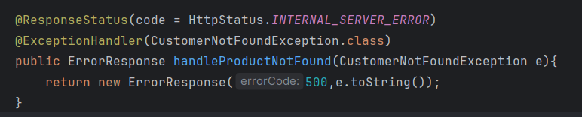
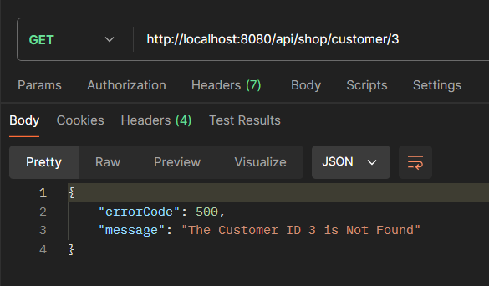
Online Shopping Application – Customer Module
Exception Class
Exception Handling
Exception Output

Slide 11
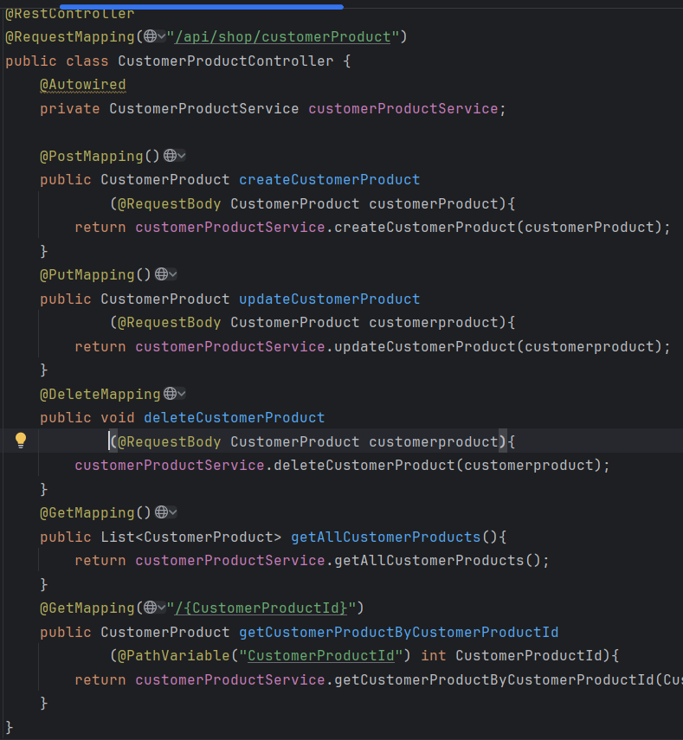
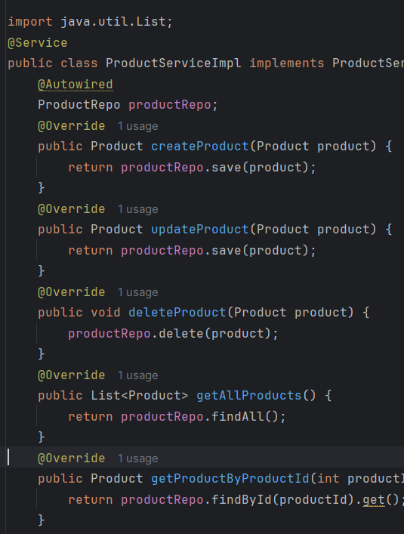
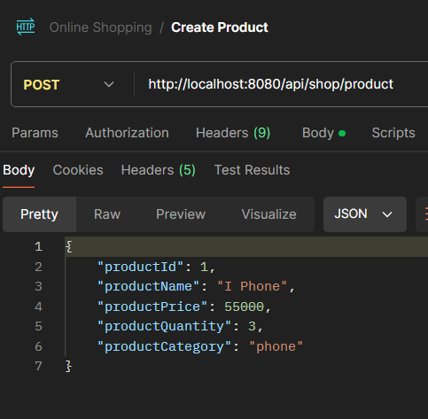
Online Shopping Application – Product Module
Product Module Endpoints
Product Module Service Class
Product Output

Slide 12
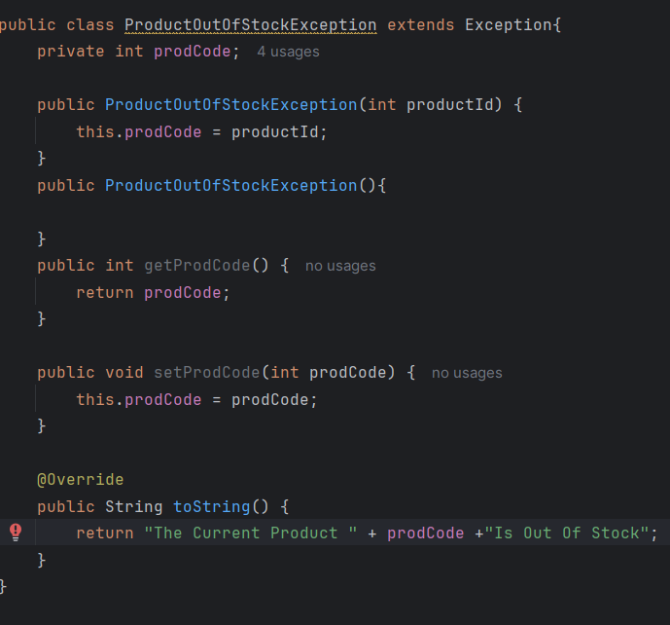
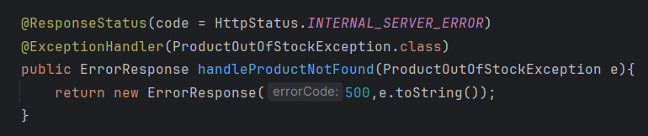
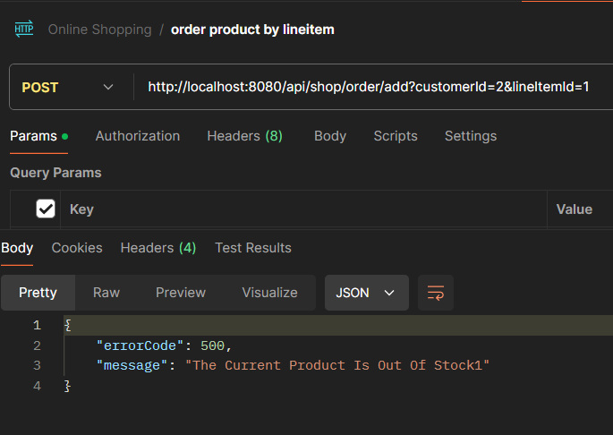
Online Shopping Application – Product Module
Exception Class
Exception Handling
Exception Output

Slide 13
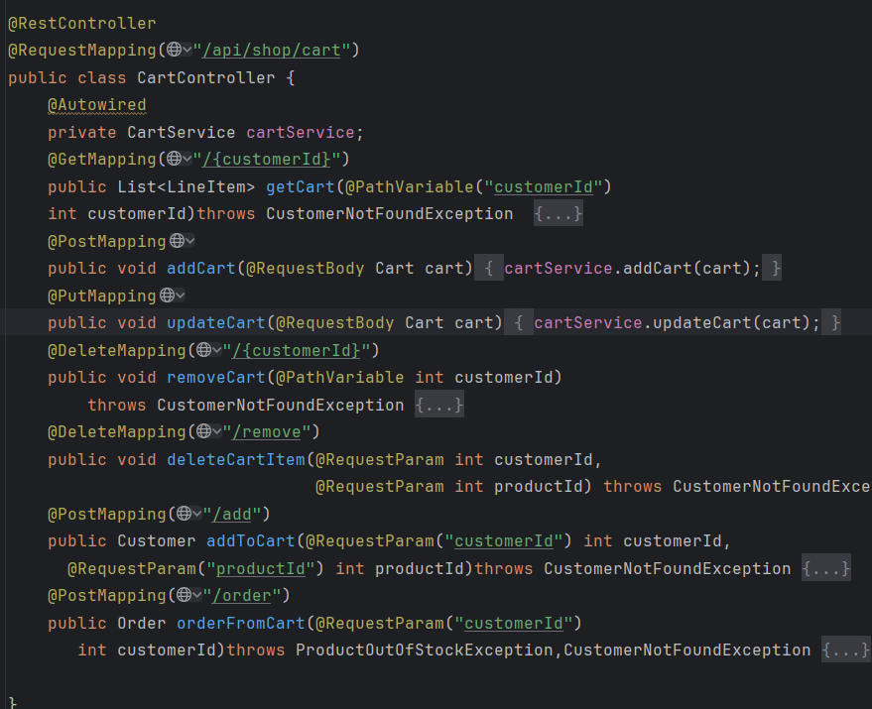
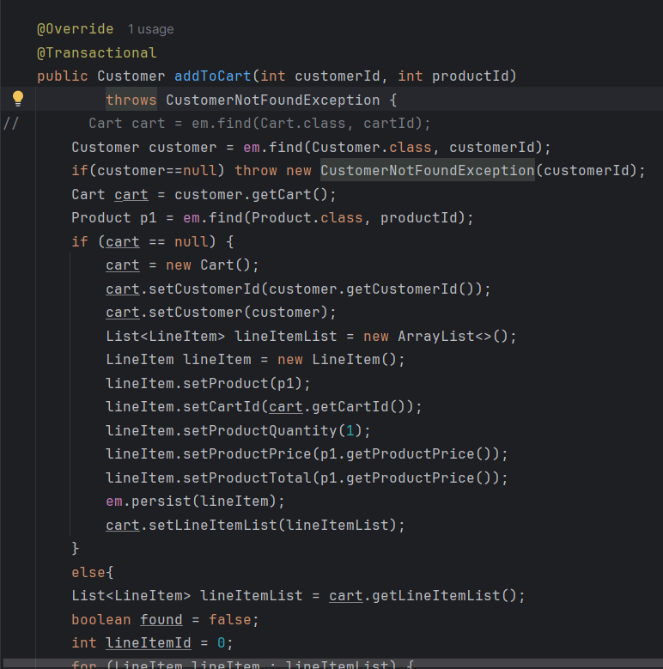
Online Shopping Application – Cart Module
Cart Module Endpoints
Add To Cart Implementation

Slide 14
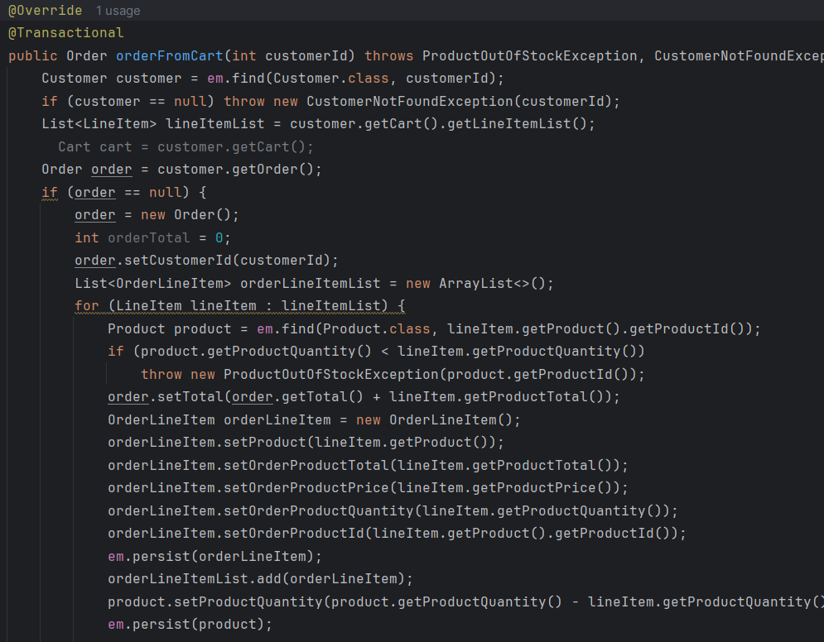
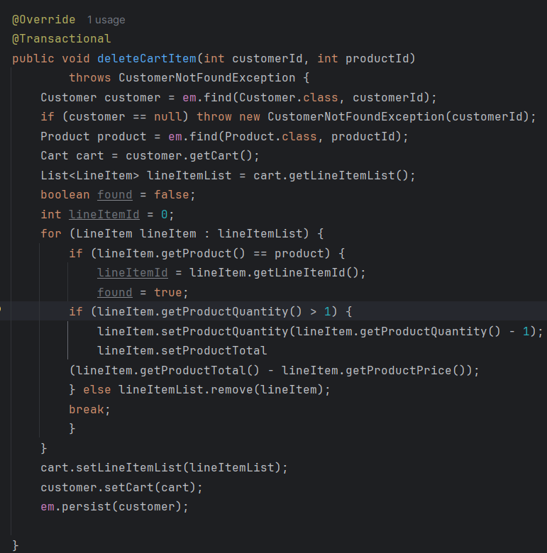
Online Shopping Application – Cart Module
Order Products From Cart Implementation
Delete Cart Implementation

Slide 15
Online Shopping Application – Product Module
Exception Class
Exception Handling
Exception Output

Slide 16
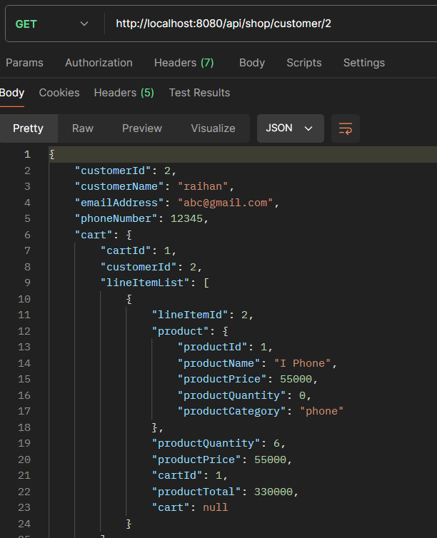
Online Shopping Application – Order Module
Order Products From Cart Implementation
Cart Output

Slide 17
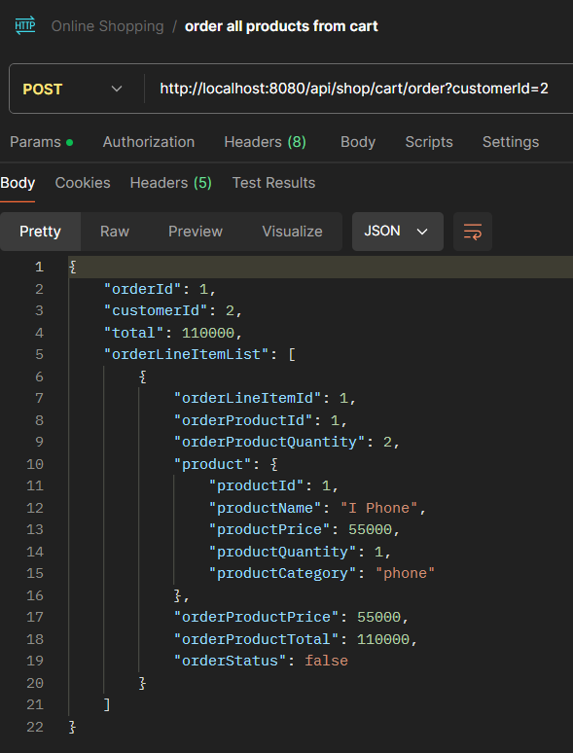
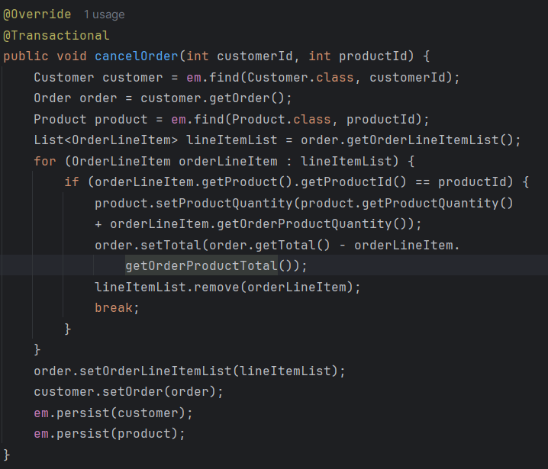
Online Shopping Application – Order Module
Cancel Order Implementation
Order Output

Slide 18
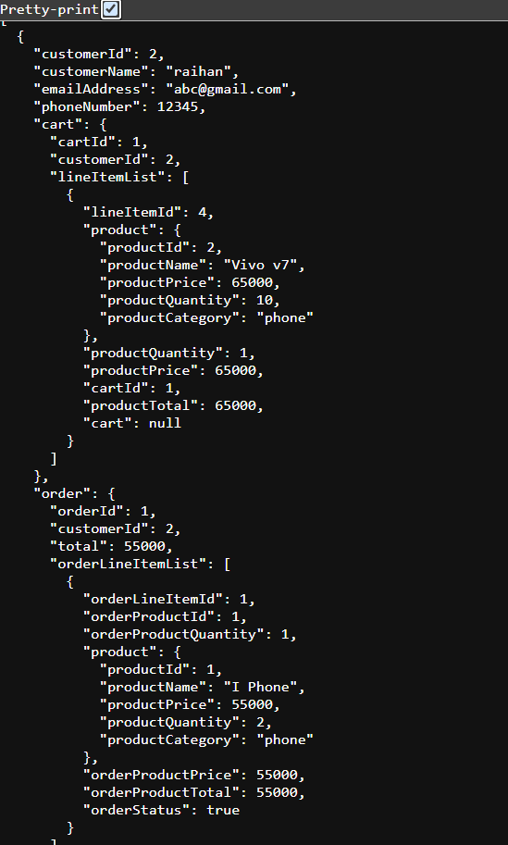
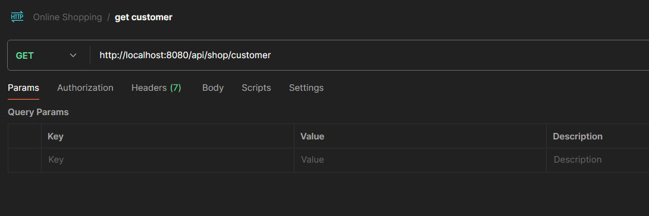
Important areas of the Project with screenshots
Displaying Customer:

Slide 19
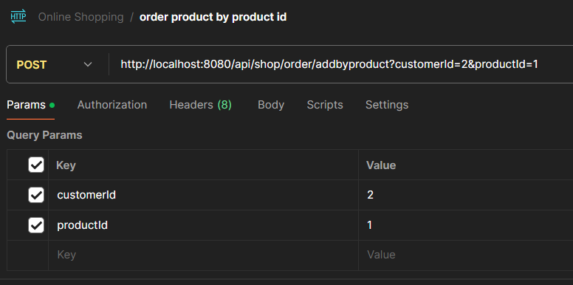
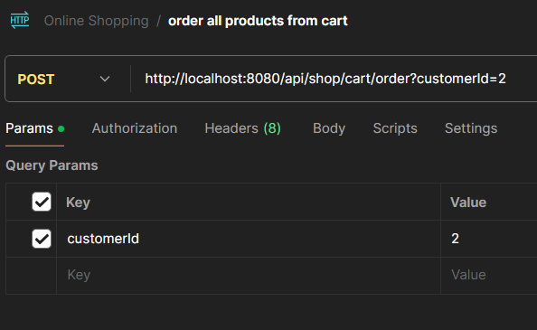
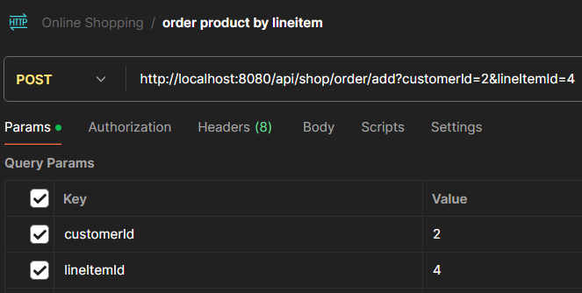
Important areas of the Project with screenshots
ORDERING PRODUCT:
Ordering Products Directly
Ordering All Products From Cart
Ordering Specific From Cart

Slide 20
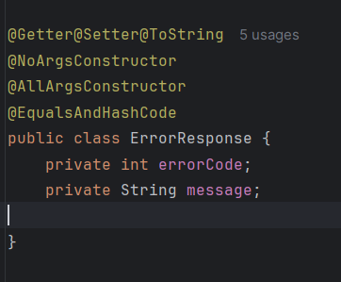
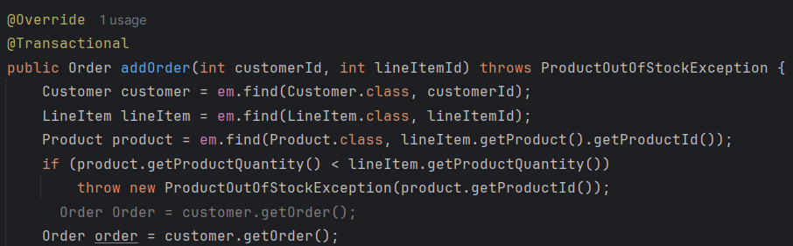
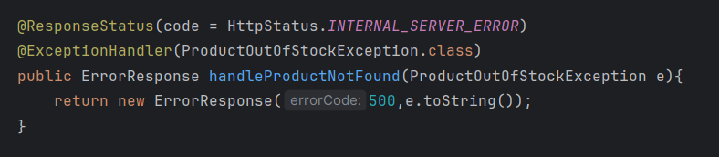
Important areas of the Project with screenshots

Slide 21
Through this capstone project, I developed a complete backend Spring Boot application composed of multiple interdependent modules, all interconnected through entity relationships.
Conclusion

Slide 22
Thank You

